Slide 1
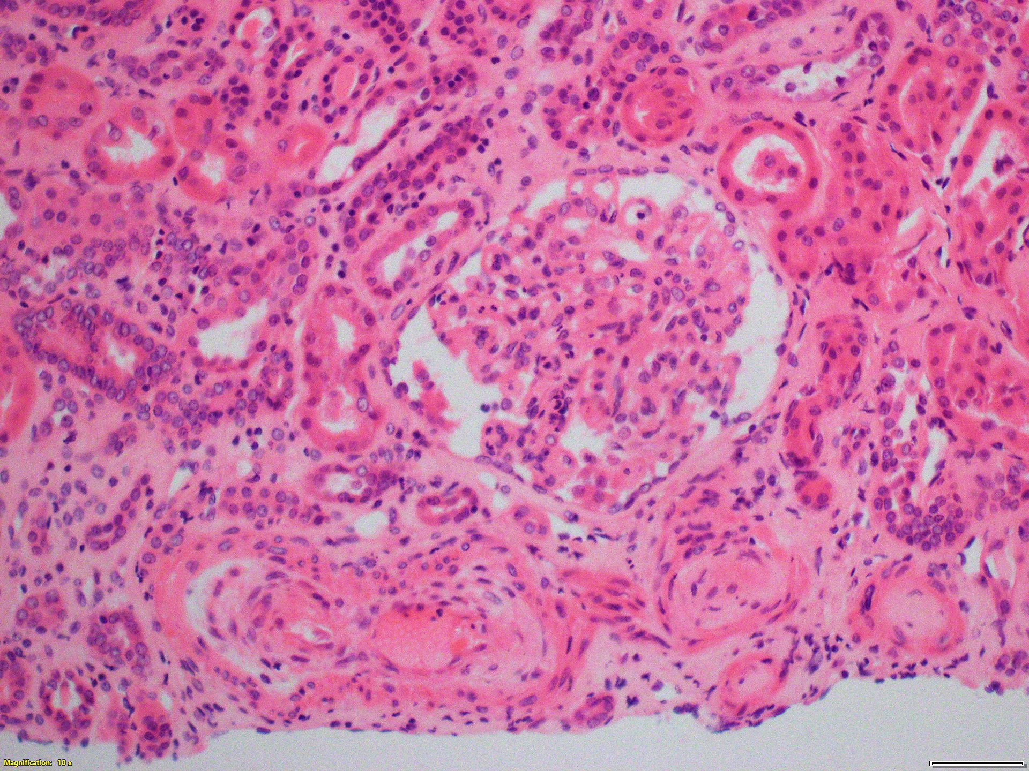
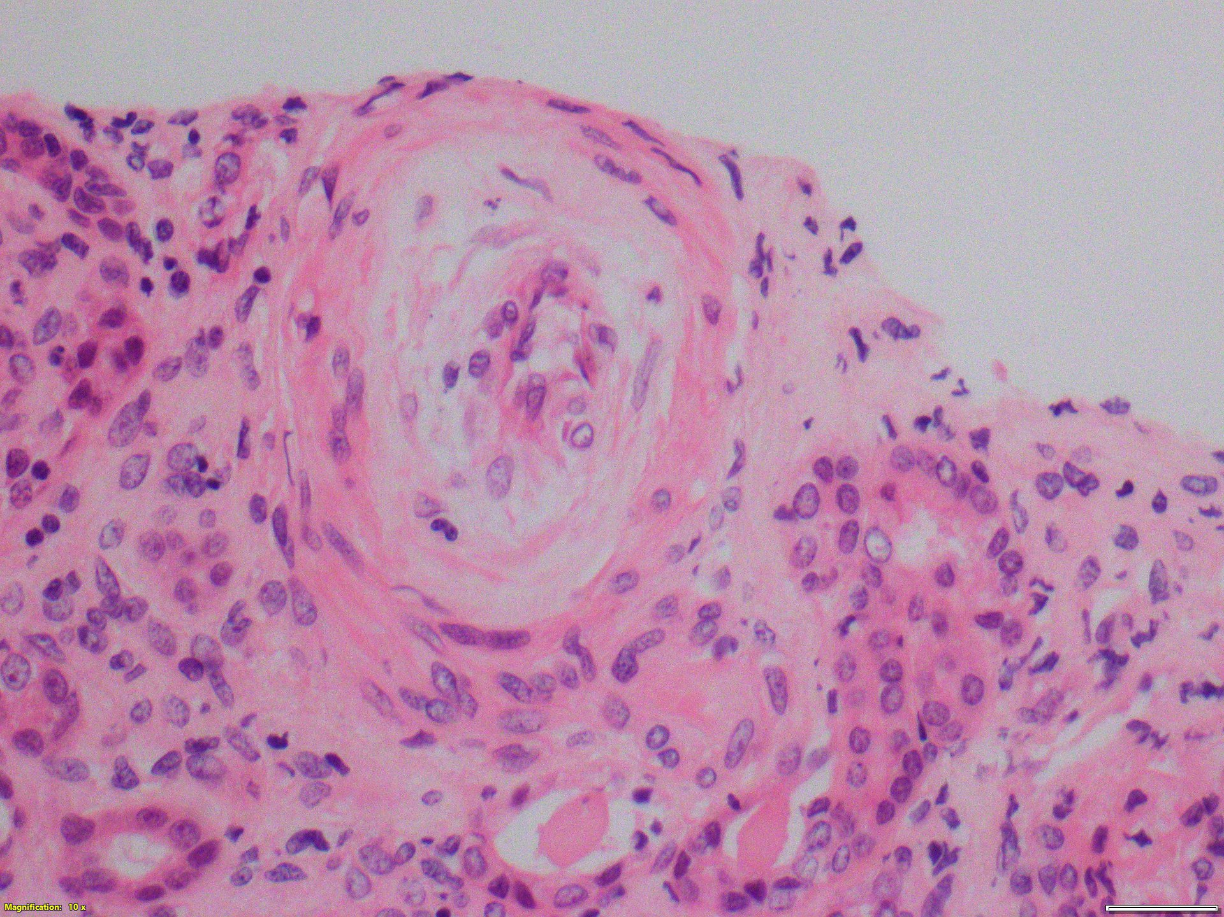
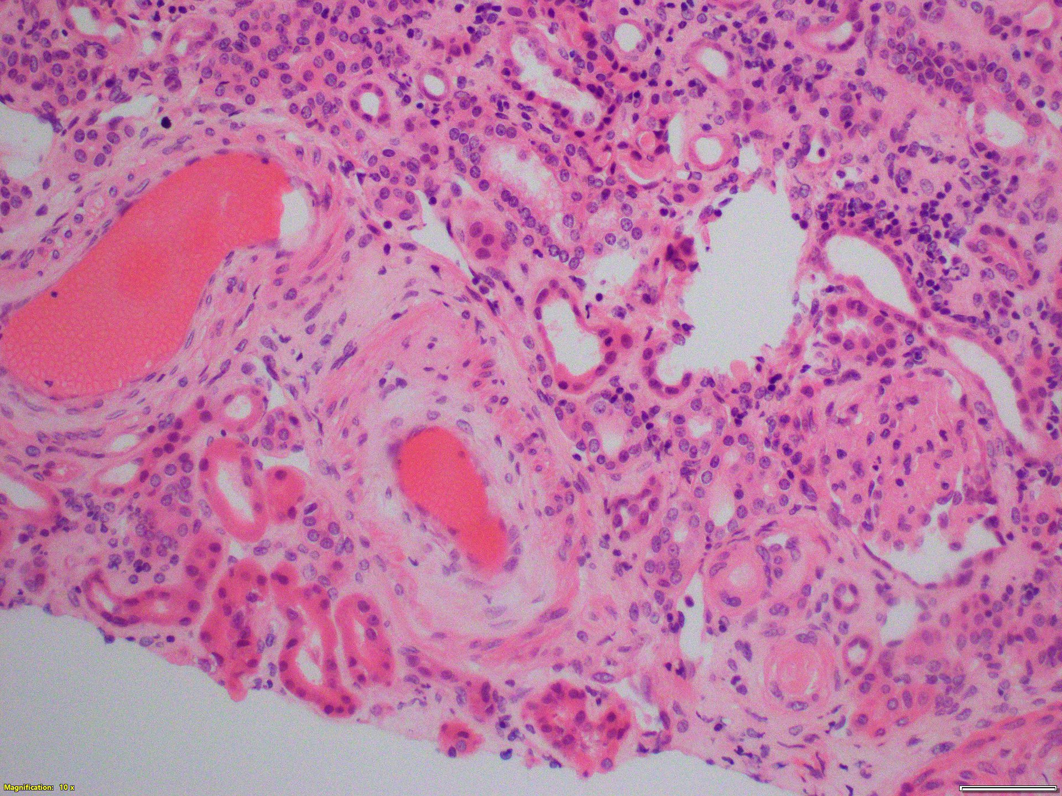
THROMBOTIC MICROANGIOPATHY AND CHRONIC KIDNEY DISEASE DUE TO EXCESSIVE COVID-19 VACCINATION - A CASE REPORT
Maja Mizdrak¹, Mirko Luketin¹, Ivo Mohorović¹, Tonći Brković¹,
Merica Glavina Durdov¹, Danica Galešić Ljubanović²
1 University Hospital of Split, Split, Croatia
2 University Hospital Dubrava, Zagreb, Croatia
This is a case of 36-year old male patient with thrombotic microangiopathy due to excessive COVID-19 vaccination (> 50 times) with the aim of making money. He suffered from hypertension but he did not take medications regularly and was prone to taking drugs and risk behavior.
The present illness started as epigastralgia and inapetente. Laboratory findings revealed leukocytes 10.6x109/L, severe normocytic anemia (Hgb 79 g/L) and mild thrombocytopenia 116 x10⁹/L. Creatinine was 1276 µmol/L without electrolyte disturbances. LDH was 732 U/L, sedimentation rate (128 mm/3.6 ks) and CRP 165.2 mg/L. Bilirubins were normal and haptoglobin low <0.1 g/L. Urine analysis revealed proteinuria 2+ and erythrocyturia 2+. Imunological panel was negative. In daily urine there were 295 mg of proteins and 1780 mg of B2M. Ultrasound showed normal sized kidneys with hyperehogenic parenhima. Kidney biopsy was finally performed.
LM presented 15/48 completely connectively altered glomeruli, 3 with segmental sclerosis, 14 with collapsed capillary lumen and 4 with endothelial edema. Other glomeruli were regular. IFTA affected 46% of the cortex. Moderate tubular damage was present. The lumen of arteries was extremely narrowed due to concentric thickening of the muscle wall, somewhere with fibrinoid wall necrosis. There were no IgA, IgG, IgM and C4 deposits, but C3 and C1q deposits. In the analyzed glomerulus for EM, open capillary lumens were shown with neat endothelium. GBM had a regular ultrastructure and measured average 320 nm, 214 nm-607 nm, SD 80 nm. Podocytes had a regular ultrastructure and preserved legs. Immune deposits were not found. Tubules, interstitium and peritubular capillaries had a regular ultrastructure.
The diagnosis of thrombotic microangiopathy of open etiology, with moderate activity and moderate chronicity (aHUS suspected) was set.
However, he is still addicted to chronic hemodialysis.

